Slide 1
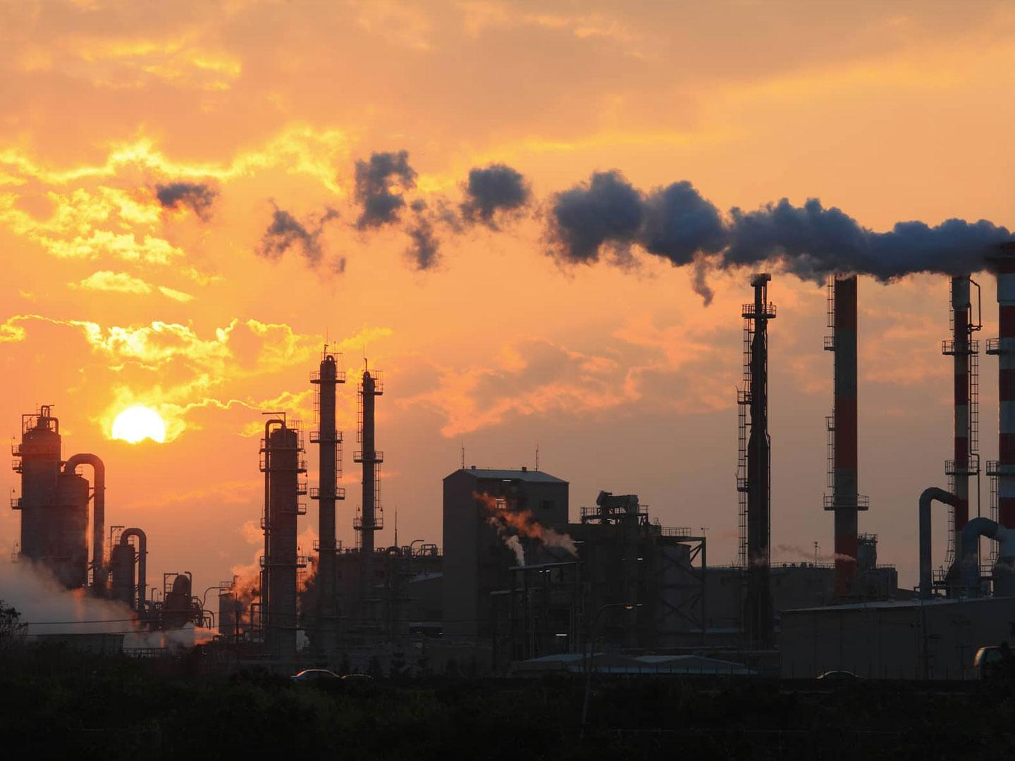
U.S. Air Quality Data
By: Valentina Gonzalez Bohorquez

Slide 2
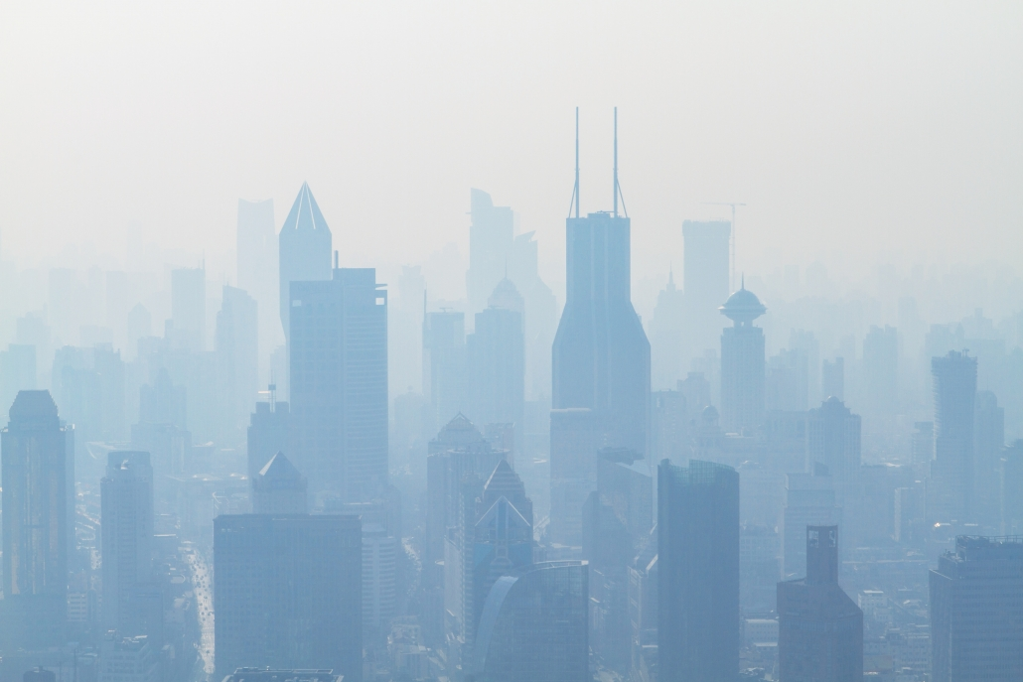
Project Goal:
To compare yearly pollutant parameter data for an specific county and state.

Slide 3
What did I do?
Obtained an API from https://aqs.epa.gov/aqsweb/documents
Wrote a function that returns pollutant parameter code given the pollutant parameter name. (EX. PM2.5 - Local Conditions)
Wrote a function that returns state code given the state name.
Wrote a function that returns county code given the state and county name

Slide 4
What did I do?
Obtained desired daily summary data with the same API, and created a function that given the state, county, parameter, and year, returned the date and max value for that parameter.
Created a final function that given the state, county, parameter, and year1 and year2, returned a table that displayed the year, average, minimum, maximum and standard deviation values for those particular years.

Slide 5
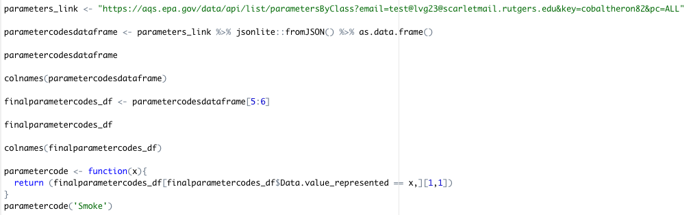

Get desired pollutant parameter code

Slide 6
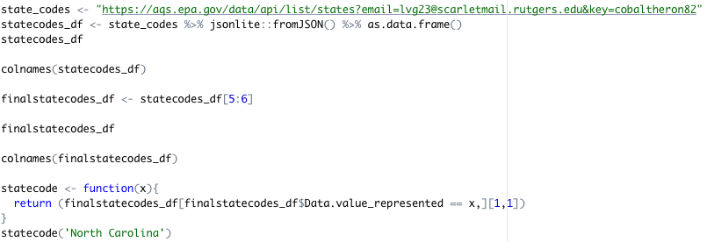

Get desired State code

Slide 7
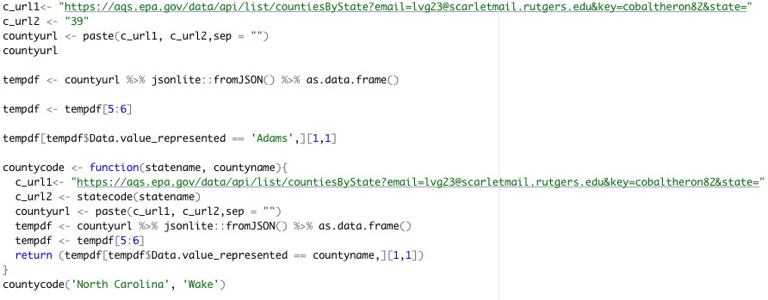
Get desired County code given the state and county name

Slide 8
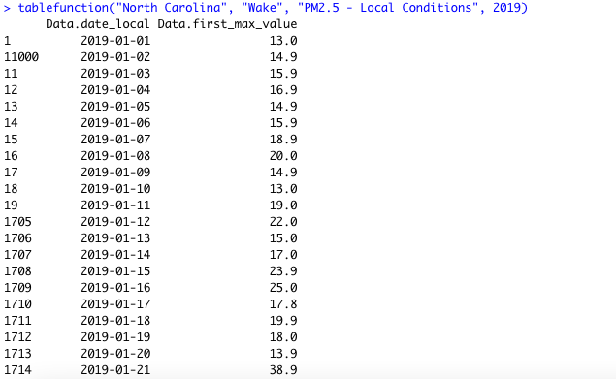
Created a function that given the state, county, parameter, and year, returned the date and max value for that parameter

Slide 9
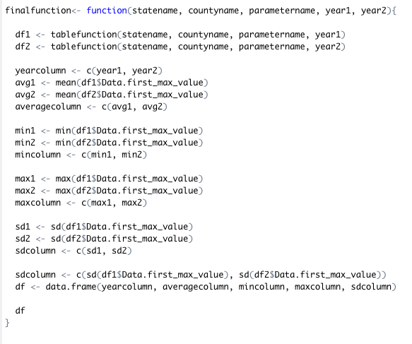

Created a final function that given the state, county, parameter, and year1 and year2, returned a table that displayed the year, average, minimum, maximum and standard deviation values for those particular years.

Slide 10
Comparing 2016 and 2020 PM2.5 levels for Bergen County, New Jersey.
We can see that the average max pollution value per day increased in Bergen County for 2020.

Slide 11

Comparing 2016 and 2020 PM2.5 levels for New York, New York.
We can see that the average max pollution value per day decreased in New York County for 2020. This decrease in pollution can be due to Covid-19 quarantine.

